Slide 1

Data Mining Project 3
Siva Chandra Kakarlapudi

Slide 2
In the fast-paced retail industry, understanding customer behavior is key. To achieve this, we’ve used customer segmentation via clustering, a machine learning technique that groups similar customers together. The dataset includes customer age, annual income, and a spending score, a metric based on customer behavior and spending habits.
The project involved EDA, data preprocessing, clustering, and cluster interpretation. Used the KMeans algorithm for clustering. The clusters were then visualized and interpreted, providing valuable insights for targeted marketing campaigns and product development

Slide 3
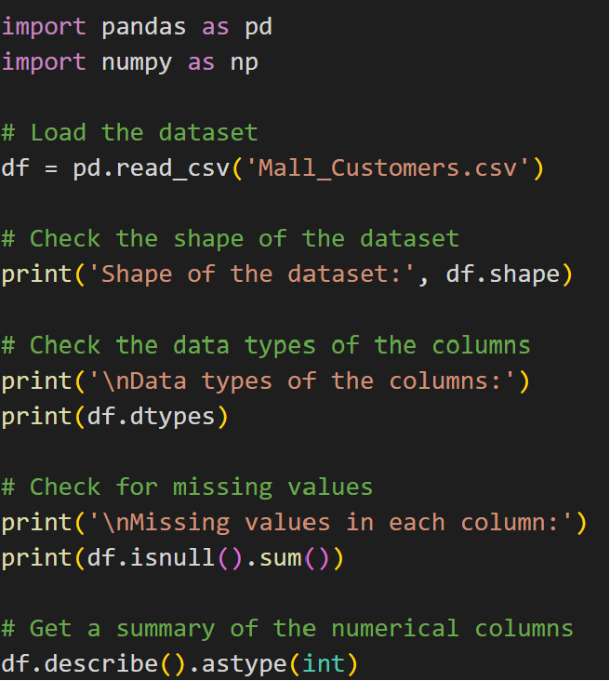
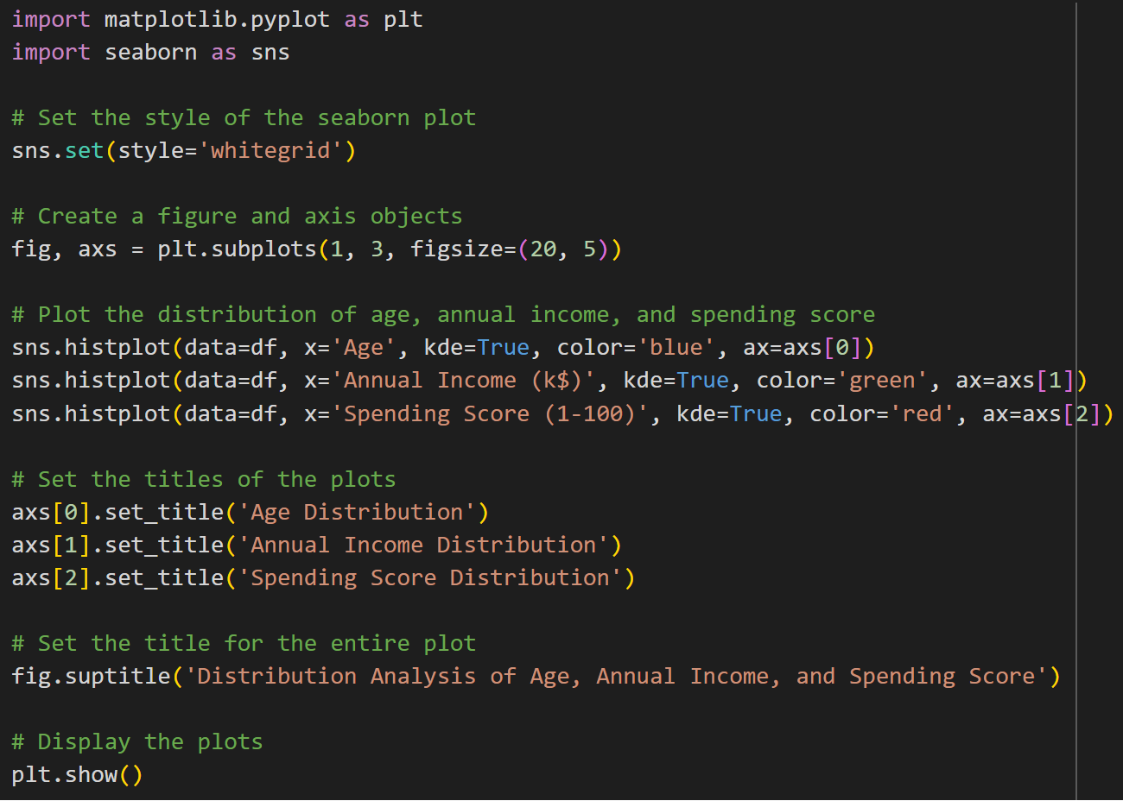
Data Preparation:
Data distribution:

Slide 4
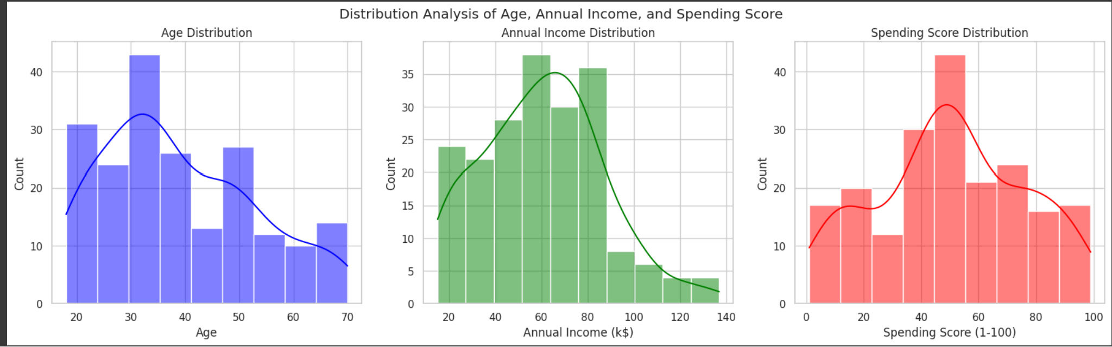
The mall’s customer base is predominantly younger, as indicated by the left-skewed age distribution. This suggests that the mall’s offerings are particularly appealing to younger individuals. Similarly, the left-skewed annual income distribution suggests that the mall attracts a wealthier clients.
The spending score distribution is centered, indicating a balanced mix of low-spending and high-spending customers. This suggests that the mall appeals to a wide range of customers in terms of spending behavior. To gain more detailed insights, the next step is to segment customers into distinct groups using a clustering algorithm based on these features.

Slide 5
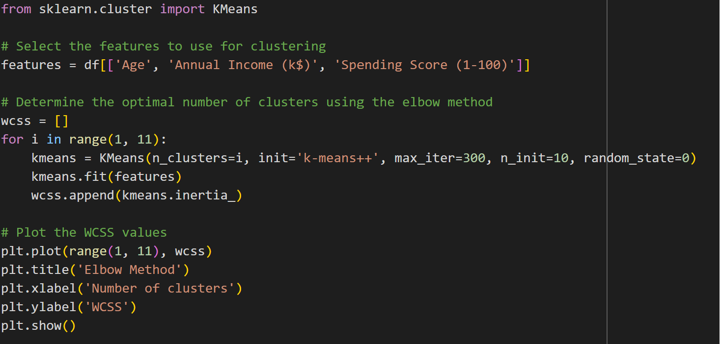
Clustering is used to categorize the customer base into groups with similarities to plan promotions and marketing accordingly
Inorder to find optimal no of clusters needed to clearly distinguish the customer base, used elbow method.
Note: The Elbow Method is a technique used to determine the optimal number of clusters for the K-means clustering algorithm. K-means requires us to specify the number of clusters beforehand, which can be challenging.

Slide 6
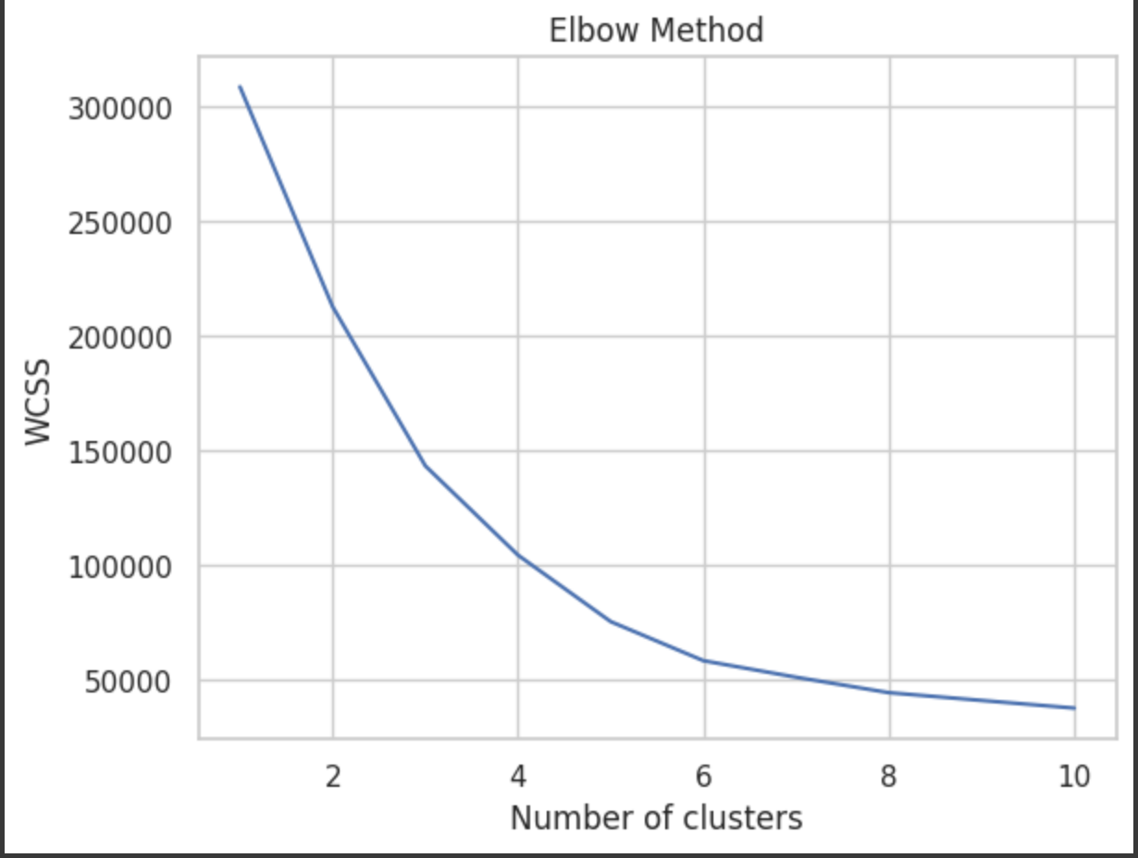
According to the above plot, the KMeans model with 5 clusters is a way of grouping our data into 5 distinct categories or “clusters” .The number 5 is chosen based on the Elbow Method above. I also tried for 3 and 4 clusters just to get a more clearer picture.

Slide 7
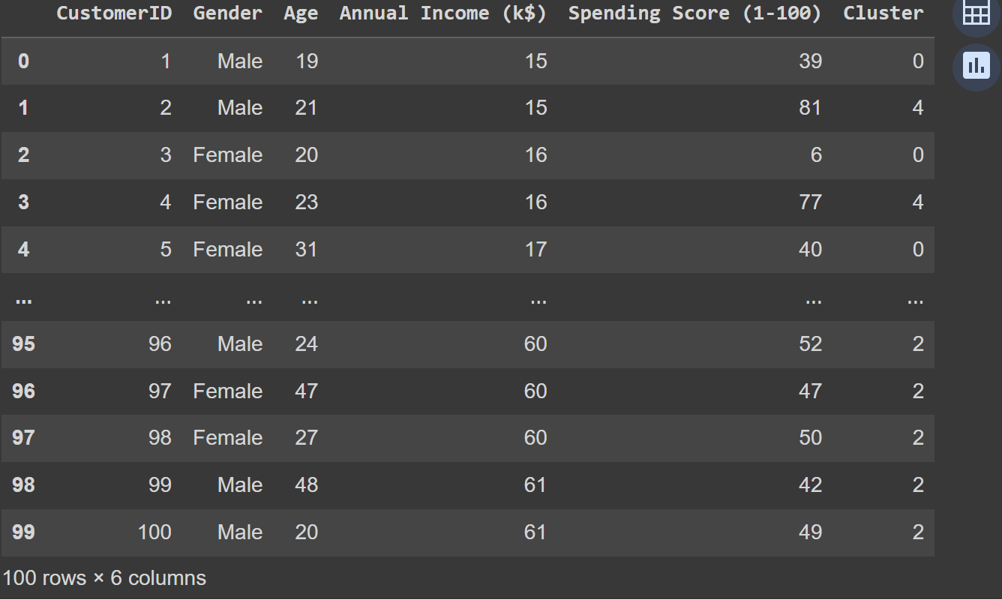
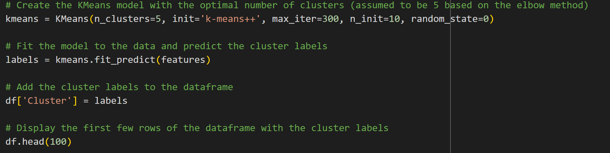
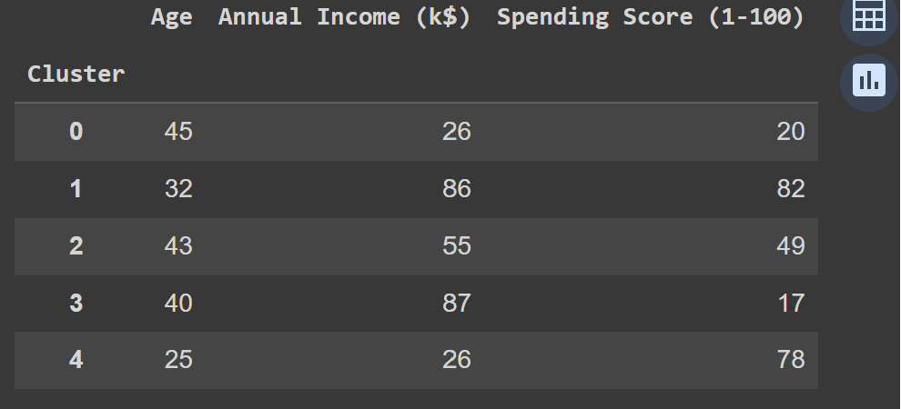
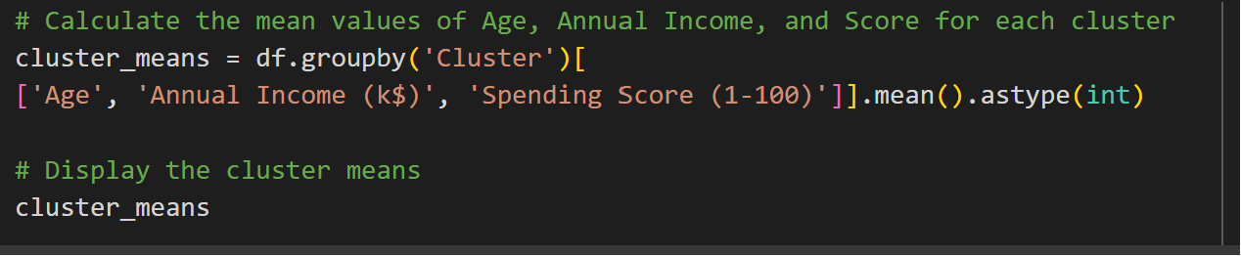
Output:
Code:
K-means clustering to 5 Clusters

Slide 8
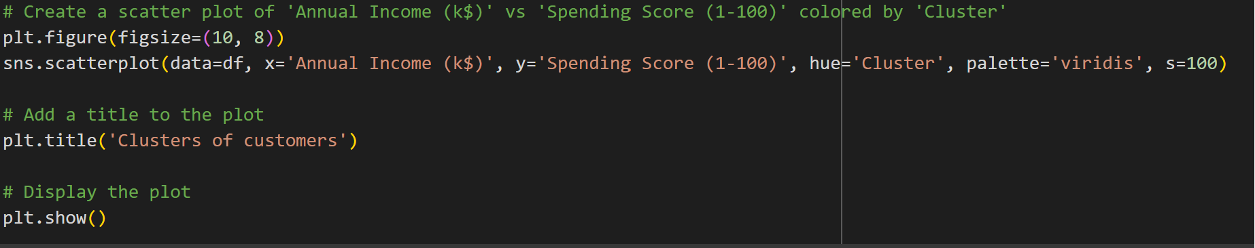
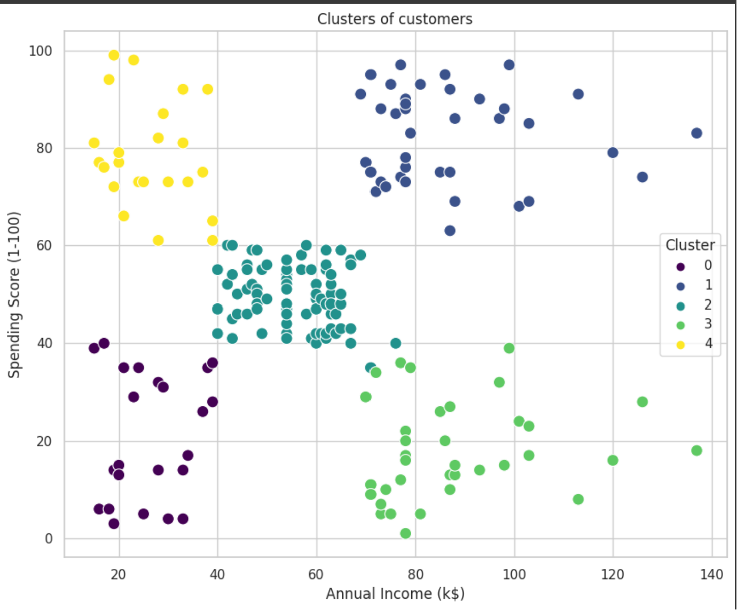
The scatter plot is a visual representation of how the KMeans algorithm has grouped the customers into clusters based on their annual income and spending score. Each point on the plot represents a customer, and the color of the point indicates which cluster the customer belongs to.
From this cluster plot between Annual Income and Spending Score the five clusters are:
Low income, low spending
High income, low spending
Medium income, medium spending
Low income, high spending
High income, high spending

Slide 9
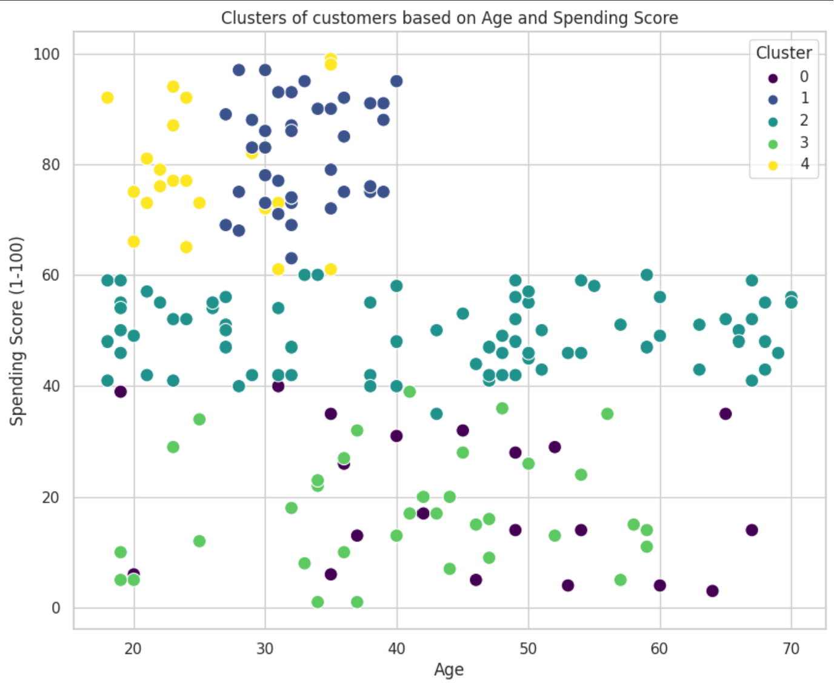
From this plot the clusters are:
Young, high spenders
Middle-aged, moderate spenders
Older, low spenders etc.

Slide 10
Medium income, medium spending: Customers with an annual income between 40 and 80k and a spending score between 40 and 60. These customers have moderate incomes and spending habits. This is the most concentrated cluster, indicating a large number of customers fall into this category.
Older, low spenders: This cluster represents older customers who have low spending scores. They might be more frugal or less attracted to the products offered.

Slide 11
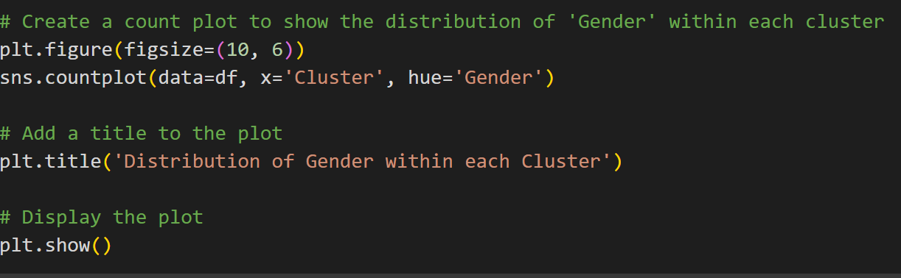
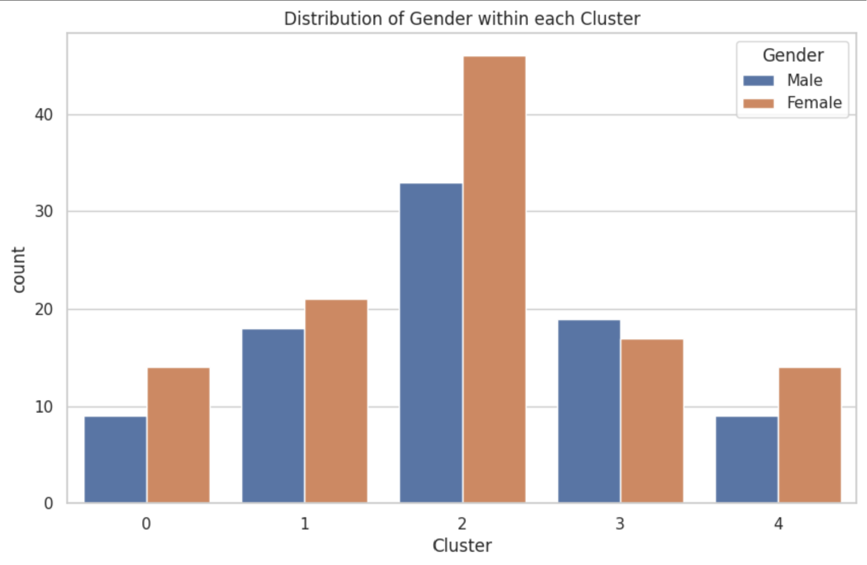
The Cluster 2 stands out with a significantly higher proportion of women. This suggests that middle-aged women with moderate spending habits form a key demographic for this mall.

Slide 12
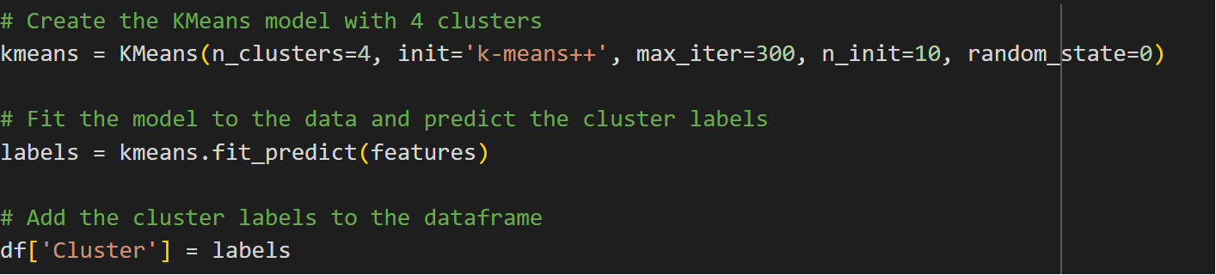
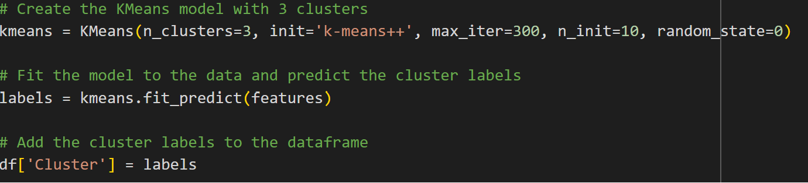

Slide 13
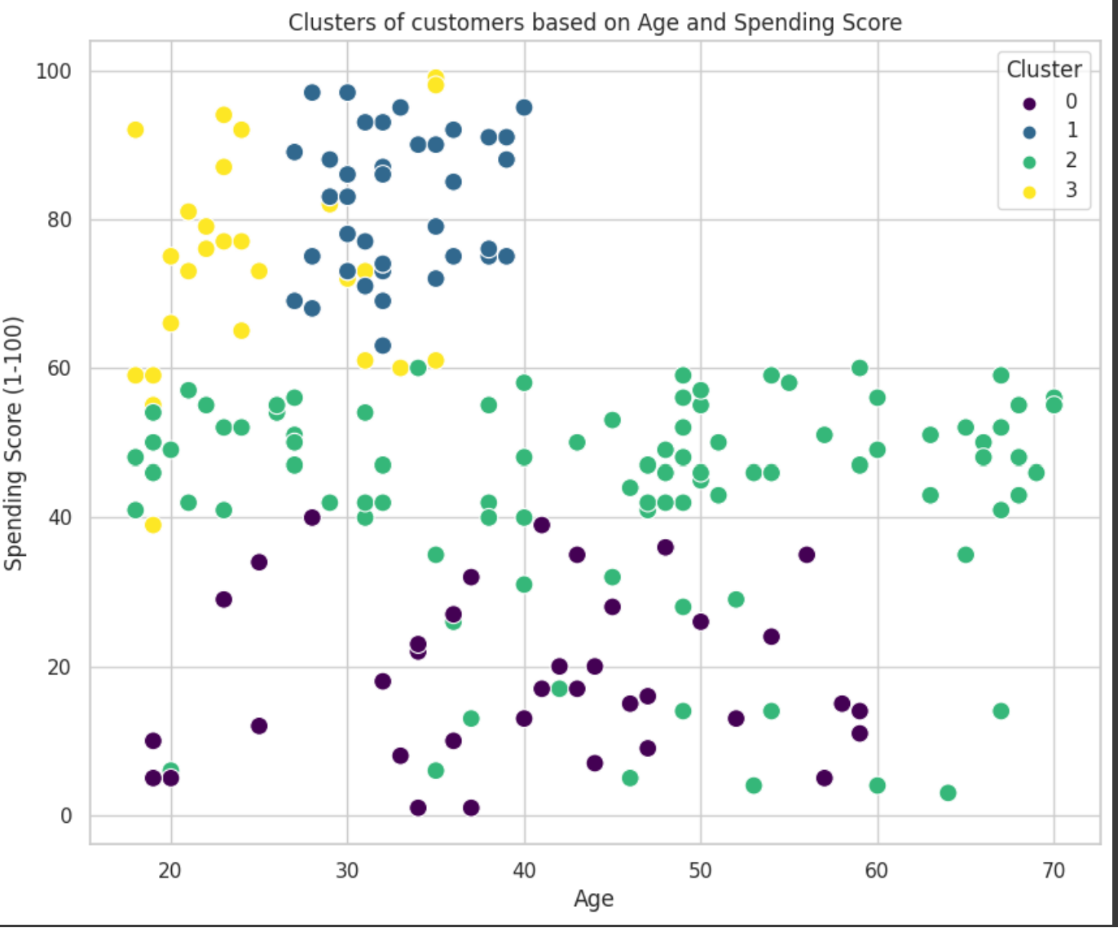
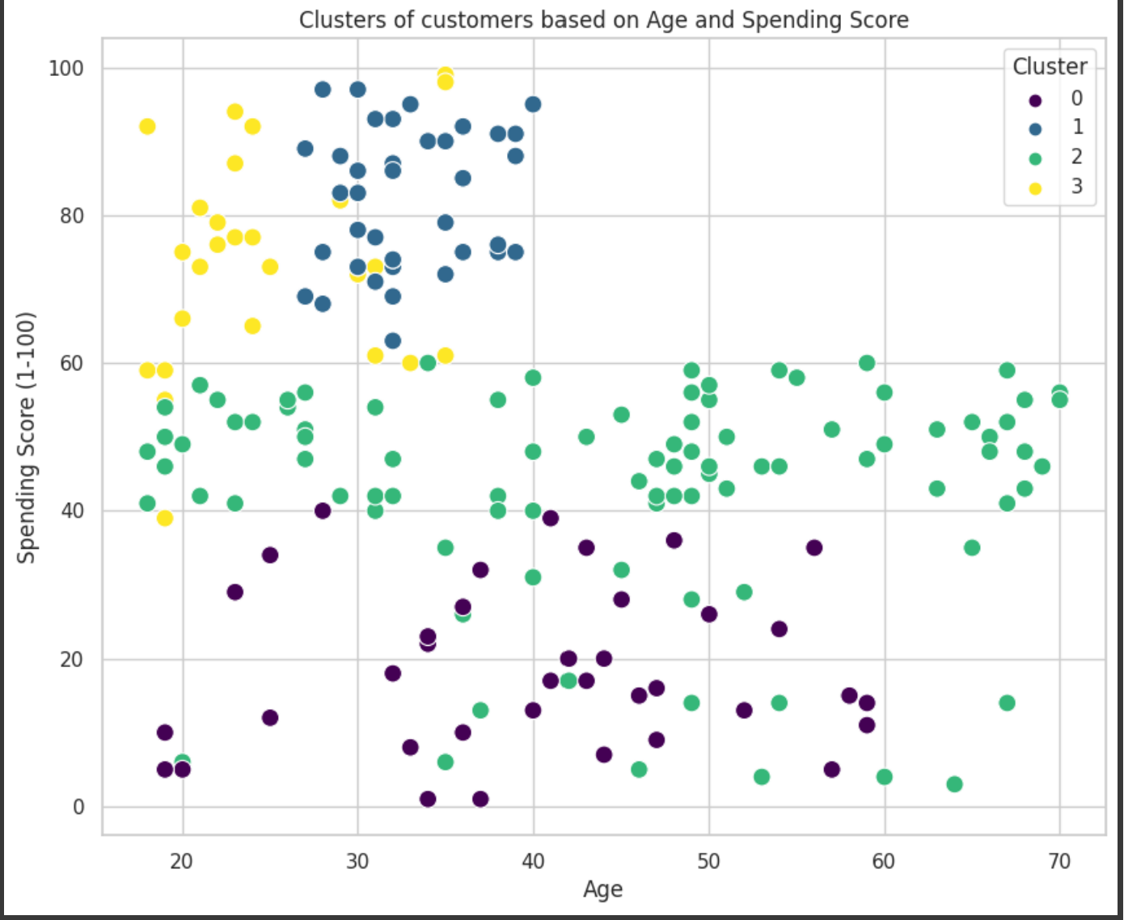
Plots when k is 4. which is considering 4 clusters

Slide 14
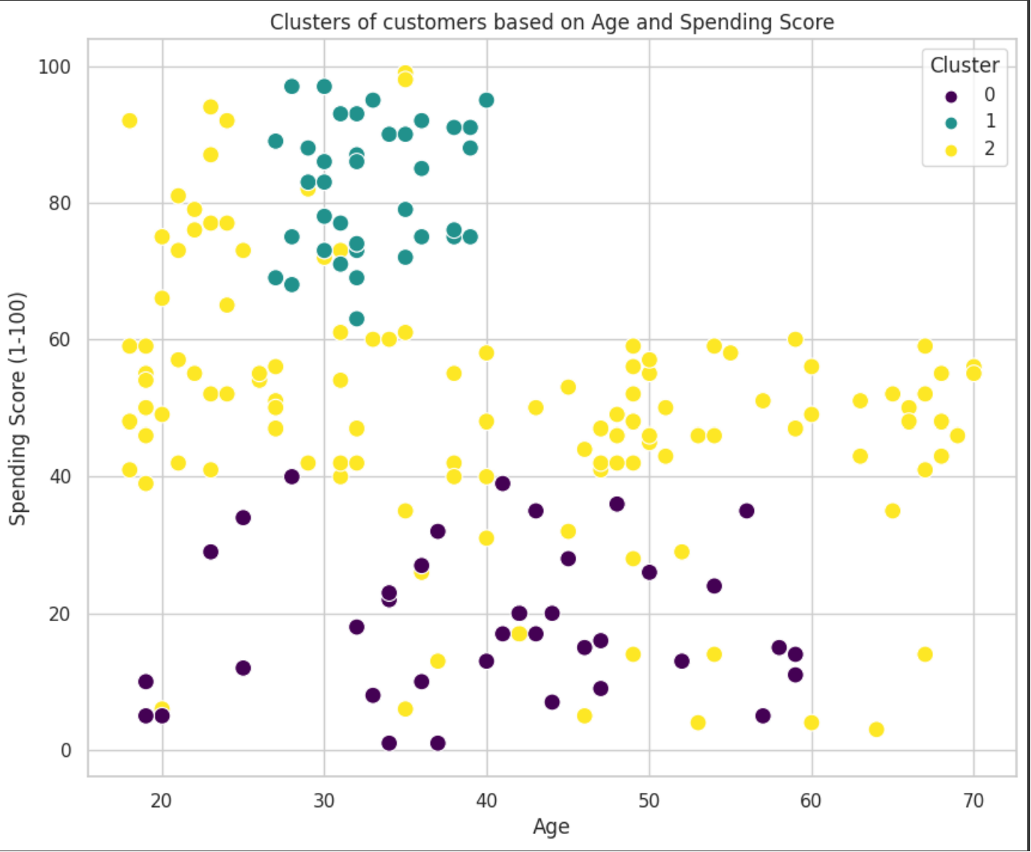
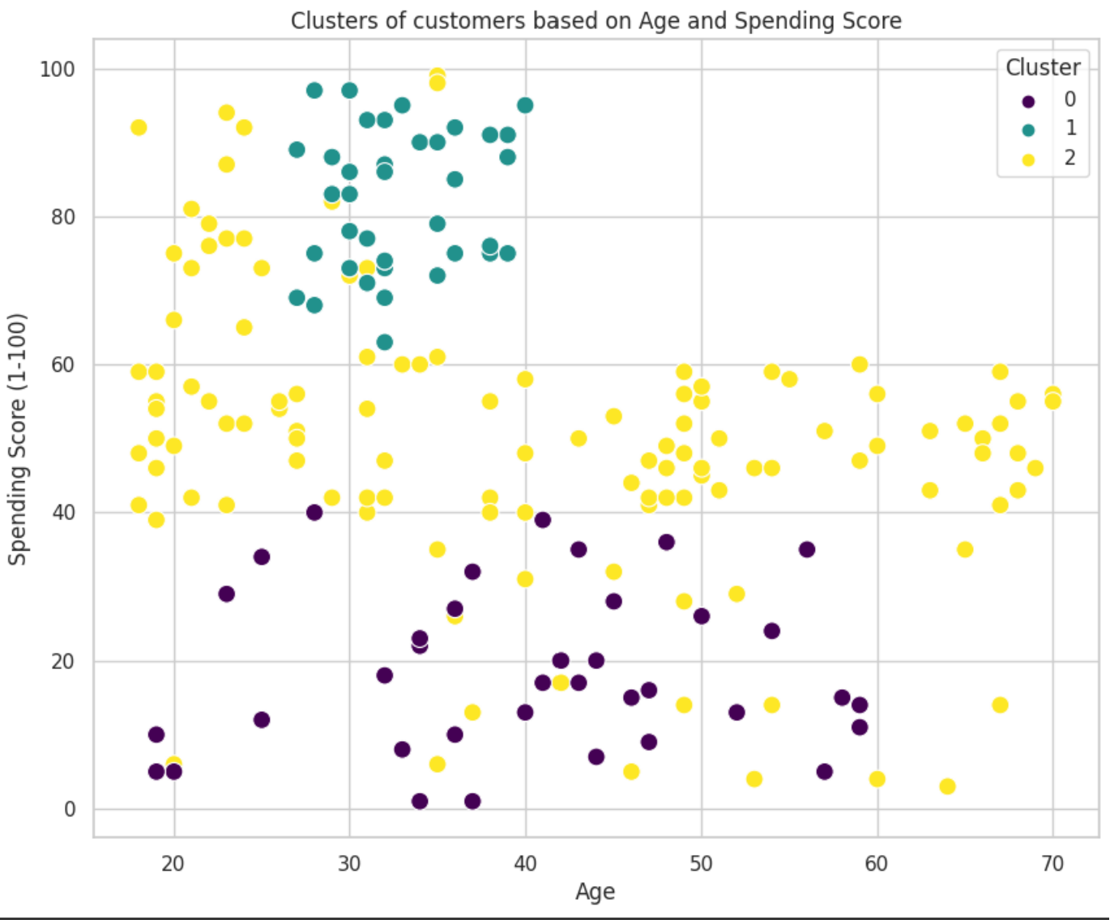
Plots when k is 3, three clusters

